Slide 1

DSN2098 – Project Exhibition 1 Web Application For Multiple Disease Prediction
Members:
Mehul Kumar Patel , Ayush Yadav , Mayank Rathore, Muskan Kumari , Archita Bajpai
Supervisor:
Dr. Komarasamy G, Associate Professor (Grade-2)
School of Computing Science and Engineering
VIT Bhopal University, Bhopal-Indore Highway
Kothrikalan, Sehore, Madhya Pradesh - 466114

Slide 2
Abstract
Introduction: Disease prediction is crucial in the early diagnosis and Accurate models can aid in better decision-making for preventive care.
Issues: Recent studies have utilized various machine learning models, but their performance has not been optimal due to limited model comparison and selection.
Methods: This study evaluates multiple machine learning models based on performance metrics like accuracy, precision, recall, and F1-score.
Solution: The best-performing models are identified for each disease category, enhancing prediction accuracy and reliability.

Slide 3
Objectives
Identify Suitable Models
Research and select machine learning models like decision trees, SVMs, and neural networks for predicting diseases such as diabetes, heart disease, and more.
Focus on models that have shown strong predictive accuracy in healthcare datasets.
Compare Models on Performance Metrics
Evaluate models based on accuracy, precision, recall, and F1-score to determine the most effective ones for each disease.
This comparison will highlight the strengths and weaknesses of each model for disease prediction.
Implement the Best Model for Each Disease
Use the top-performing model for each disease, ensuring optimal prediction accuracy and reliability.
This ensures that each disease is predicted with the most appropriate model for its characteristics.
Develop a Web-Based Application
Build a user-friendly web app that enables real-time disease prediction by using the best models based on user-provided health data.
The application will offer easy access to reliable health insights for users in real-time.

Slide 4
Introduction
Introduction:
Machine learning has revolutionized healthcare by enabling the analysis of patient data to predict diseases like diabetes and heart disease. These tools allow for faster, more accurate predictions.
It plays a crucial role in early detection, helping doctors make better decisions.
Issues:
The main challenge is selecting the right model for each disease, as not all models perform equally well. Choosing the wrong one can lead to inaccurate results.
Evaluating models carefully is necessary to avoid overfitting or underperformance.
Contents:
This paper will explore various machine learning models, compare their performance, and propose the best model for each disease based on metrics like accuracy and precision.
The aim is to provide a clear understanding of which model is most effective for each specific disease.

Slide 5
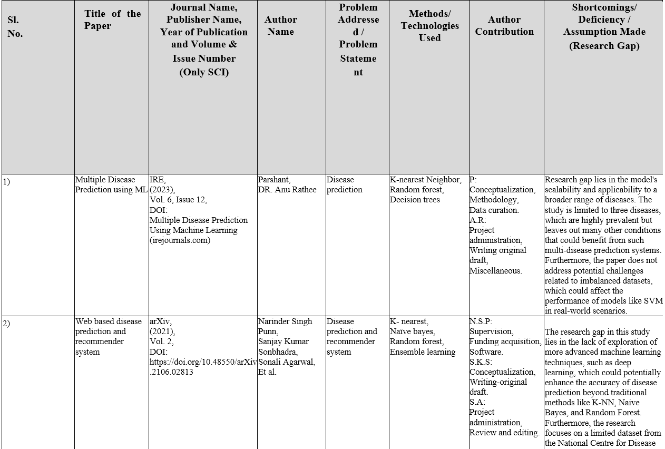
Literature Work

Slide 6
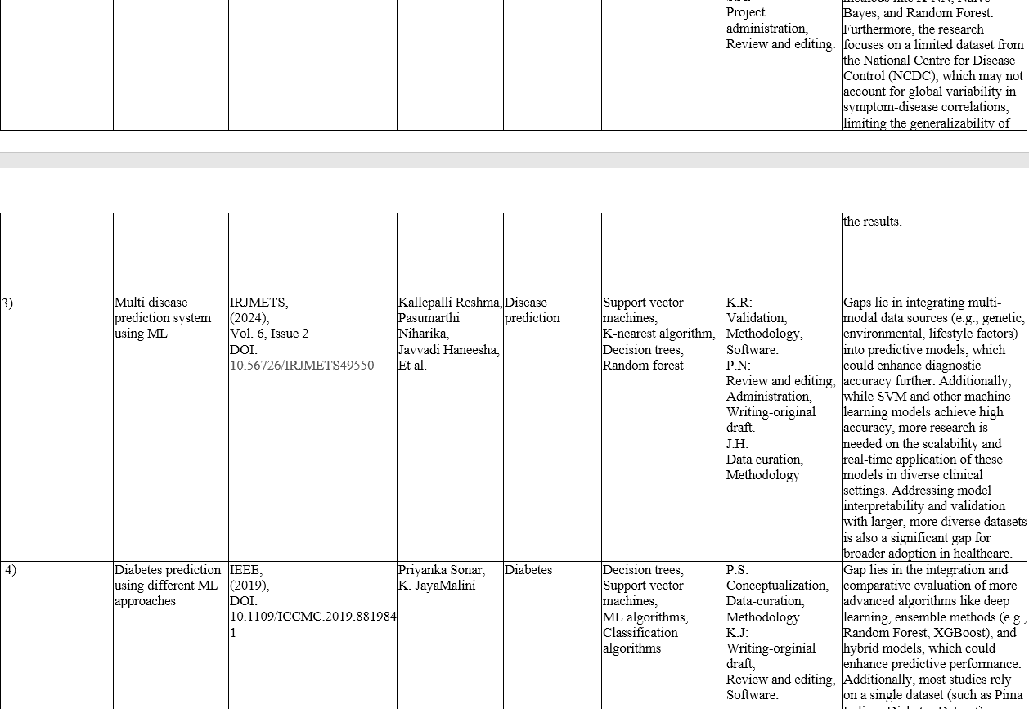

Slide 7
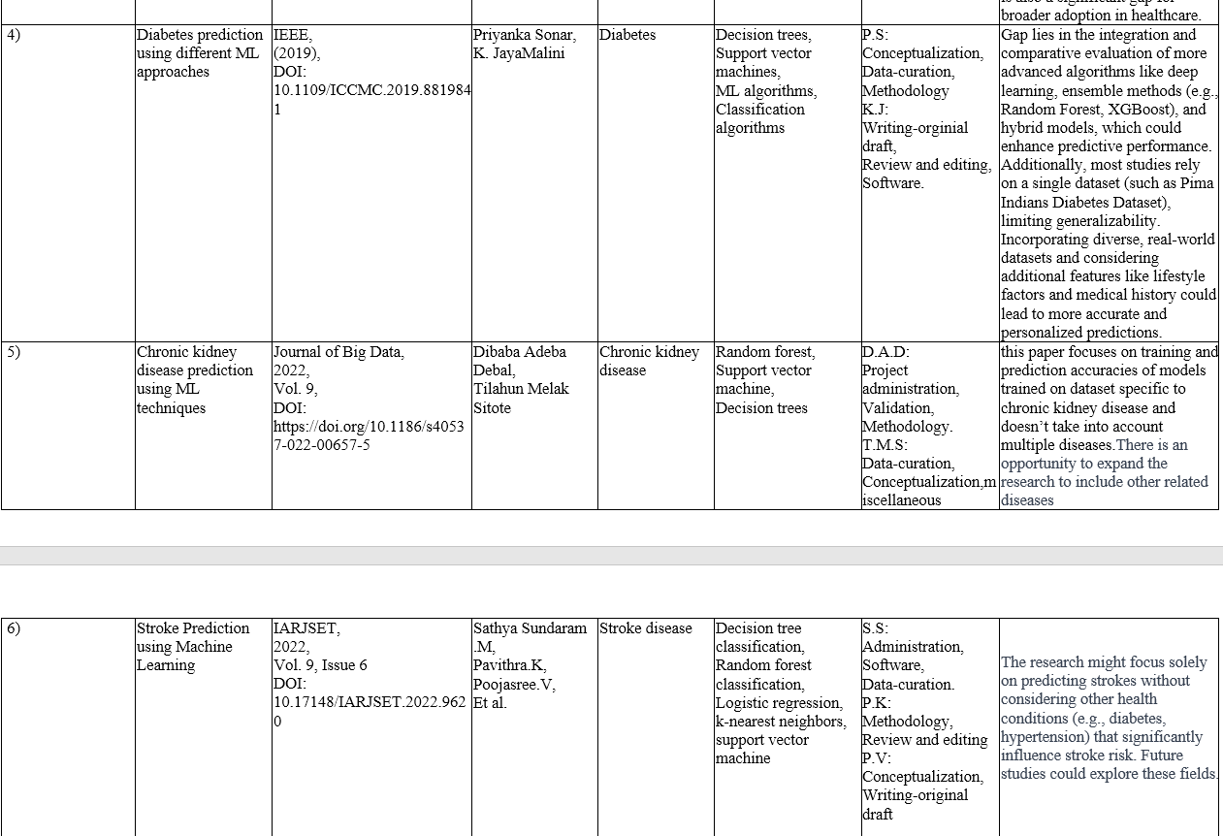

Slide 8
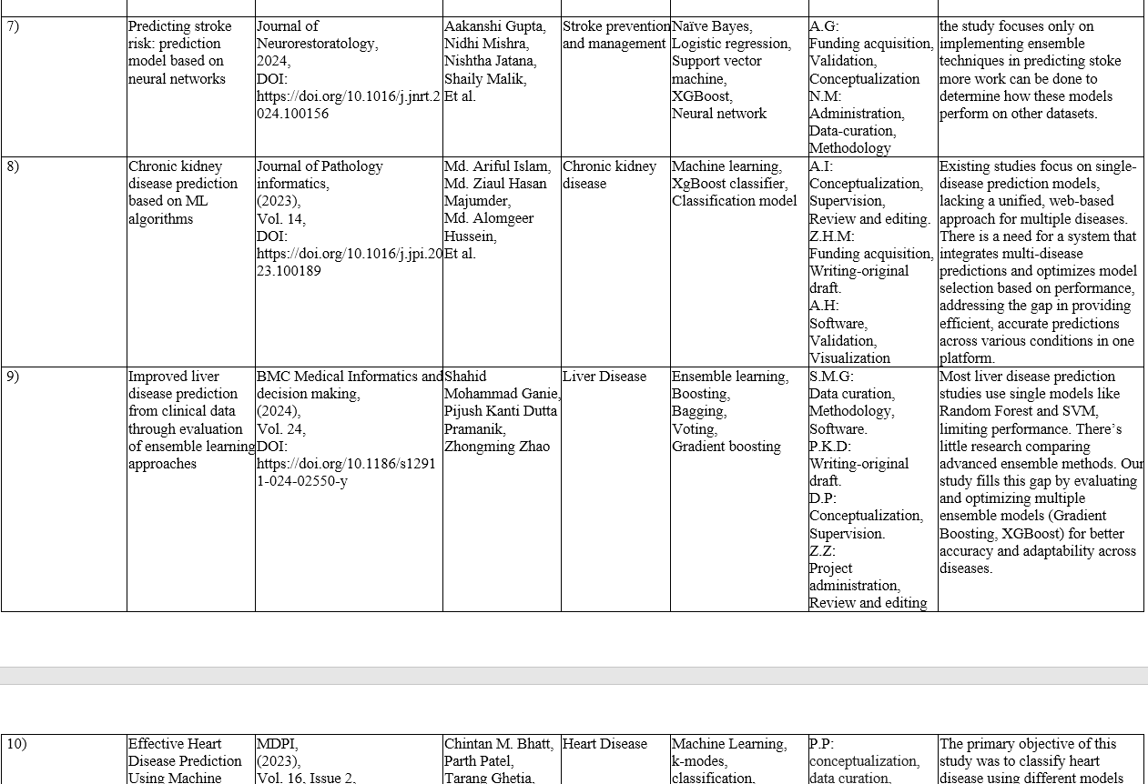

Slide 9
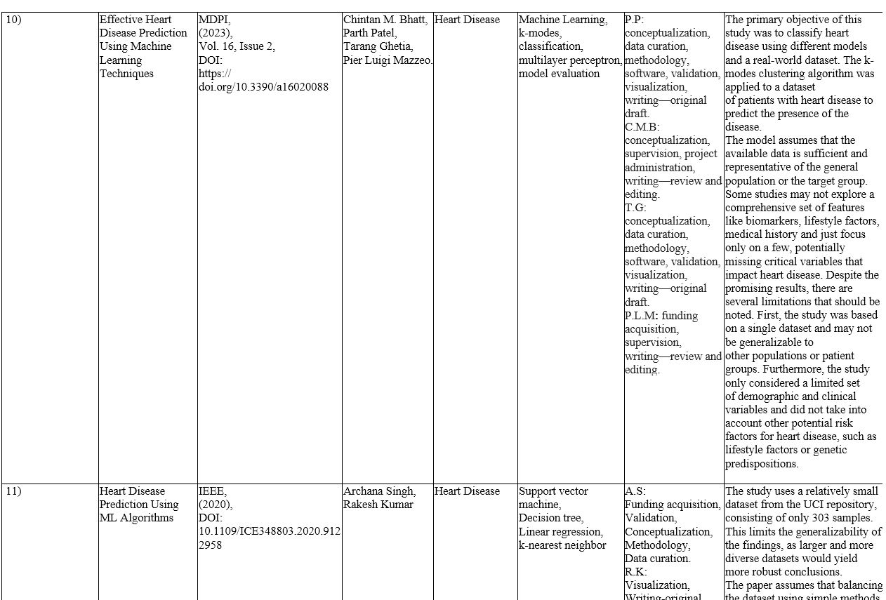

Slide 10
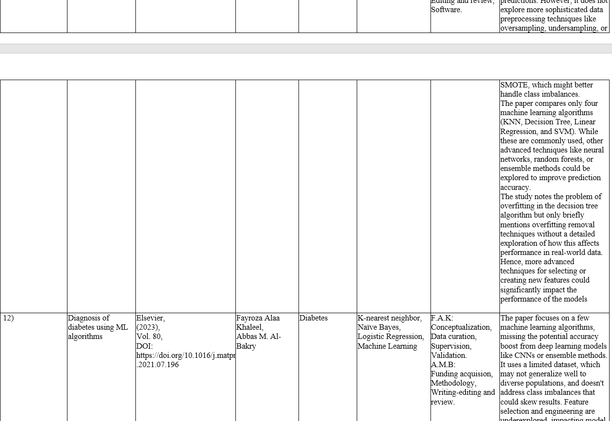

Slide 11
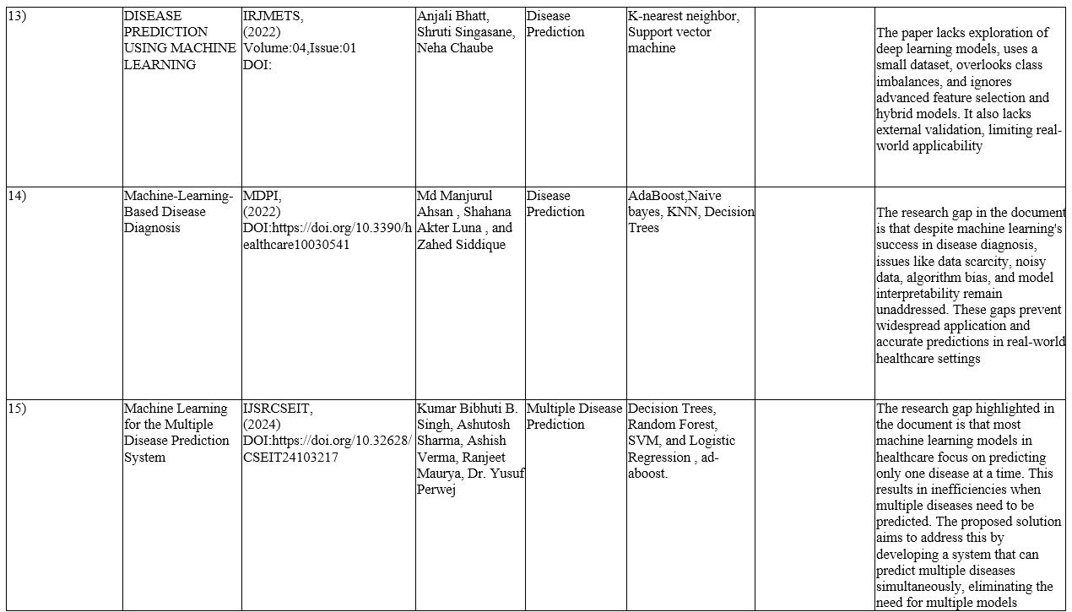

Slide 12
Existing work
Standalone Disease Prediction Models:
Most of the existing solutions focus on predicting individual diseases using specific machine learning models. These applications tend to focus on one disease at a time, limiting the scope and utility for users seeking a more comprehensive health overview.
Examples include applications like diabetes or heart disease prediction models, where only a specific condition is targeted, often using a single algorithm or fixed set of models.
Limited Model Comparison:
Existing systems rarely compare the performance of multiple machine learning models side-by-side for disease prediction. Most systems employ a predefined algorithm without testing alternatives to ensure the best possible predictive accuracy.
This approach leads to suboptimal results, as not all algorithms perform equally well for different datasets or conditions.
Lack of Web-Based Platforms for Multiple Disease Prediction:
There are few web-based platforms that allow users to predict multiple diseases in one place, particularly with a focus on leveraging the best-performing models for each disease.
Most of the available tools are either desktop-based or cater to specific, individual diseases without integrating a comprehensive, multi-disease prediction system in a web environment.

Slide 13
Proposed work
Our project is all about testing and comparing different machine learning models like Logistic Regression, Decision Trees, Random Forest, SVM, Neural Networks, and XGBoost to predict multiple diseases. The system will focus on finding the best-performing models for various disease datasets, making sure the right model is selected based on its accuracy and performance.
What sets this project apart is that it isn't just about testing models—it's about making the results easily accessible through a web-based application. This web platform will allow users to input their data and get predictions across multiple diseases, offering a streamlined, user-friendly way to access advanced machine learning predictions. By focusing on multiple diseases and providing a comprehensive performance comparison in a single place, this project brings a practical, unique edge to healthcare predictions, especially for people without a background in data science.

Slide 14
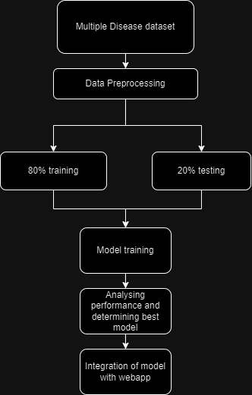
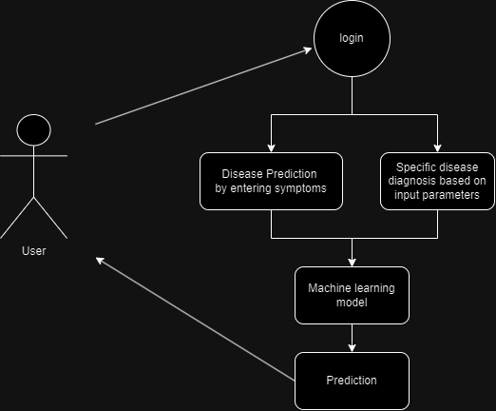
Overall Architecture diagram and flow diagram

Slide 15
Software used
Software and Hardware details with Justification
S.No | Software used | Justification
1 | Python | for implementing machine learning models (e.g., Scikit-learn, TensorFlow, XGBoost).
2 | JavaScript | For front-end development and enhancing user interaction.
3 | HTML/CSS | For structuring and styling the web interface.
4 | SQL/NoSQL | For managing databases (e.g., MySQL, MongoDB).

Slide 16
Hardware
Software and Hardware details with Justification
S.No | Hardware used | Justification
1 | Laptop With Processor: AMD Ryzen 7 RAM: 16 GB Storage: 512 GB SSD GPU: GTX1650 | For development and deployment.

Slide 17
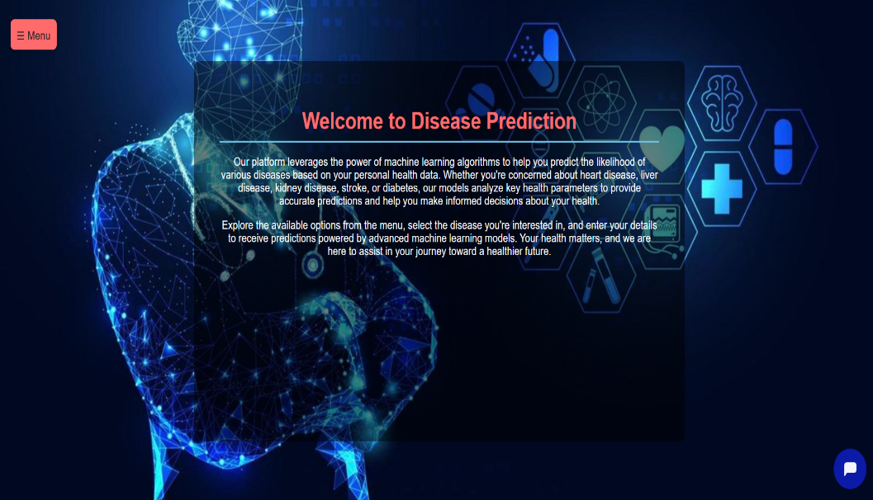
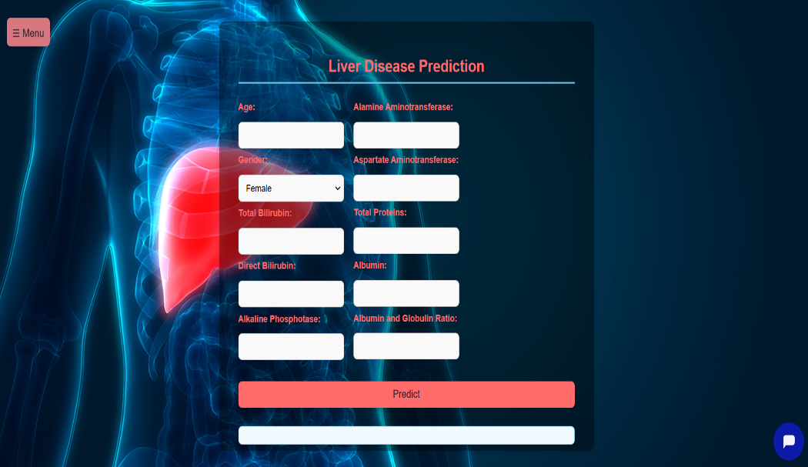
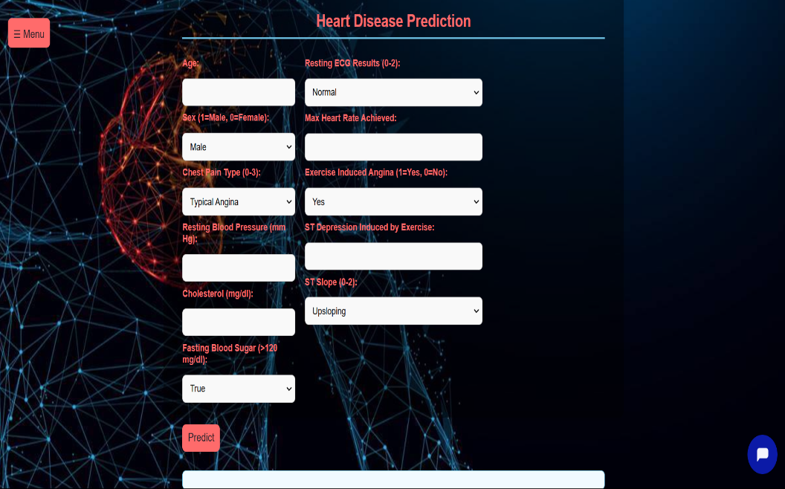
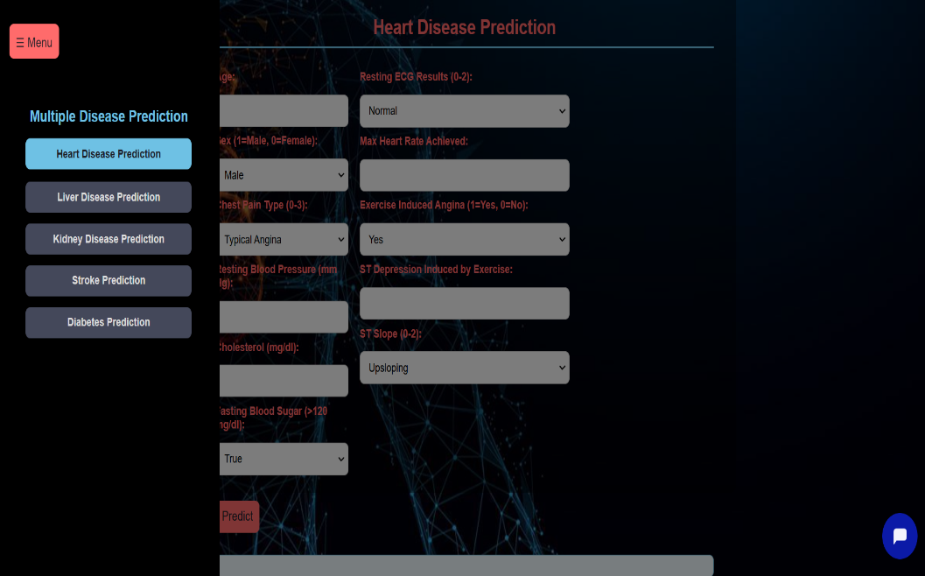
Experimental results

Slide 18
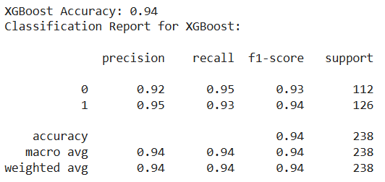
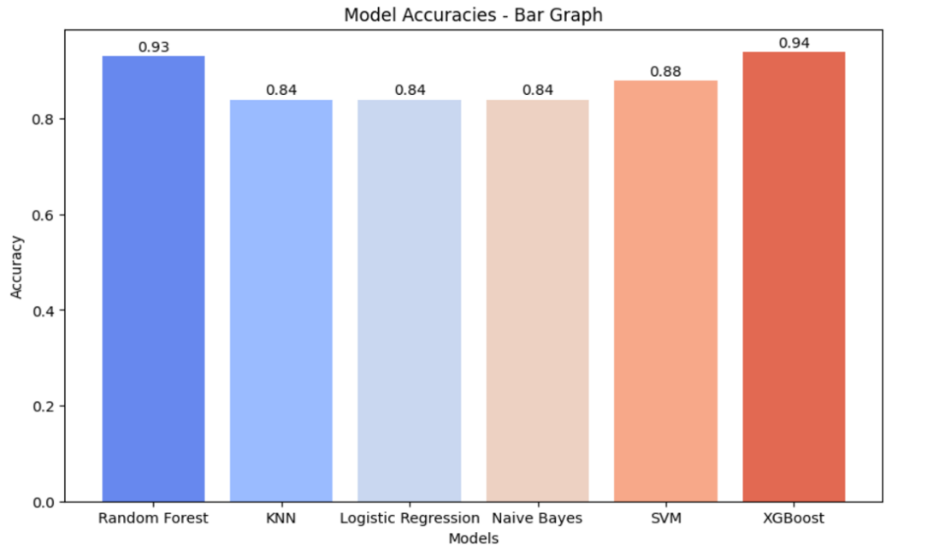
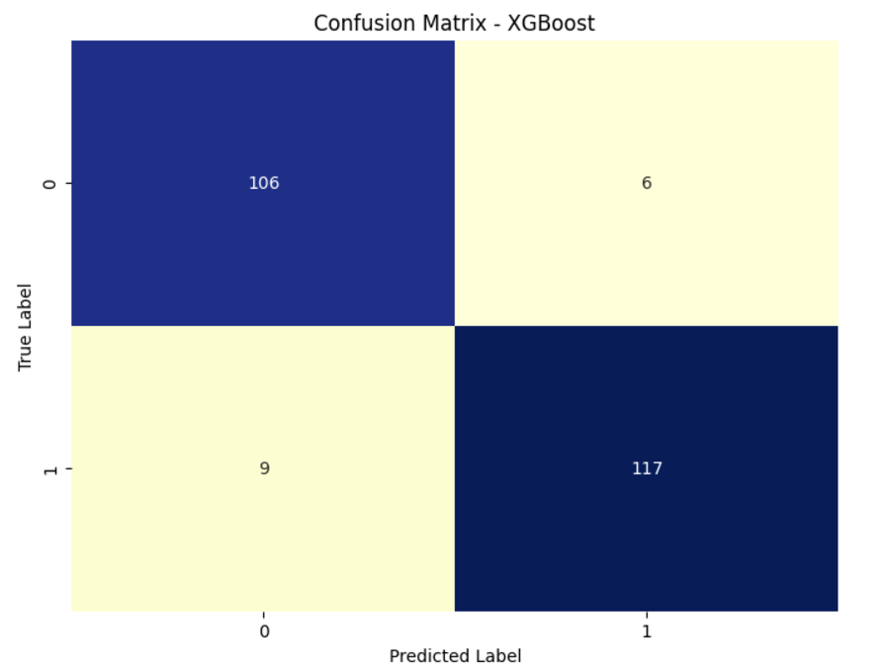
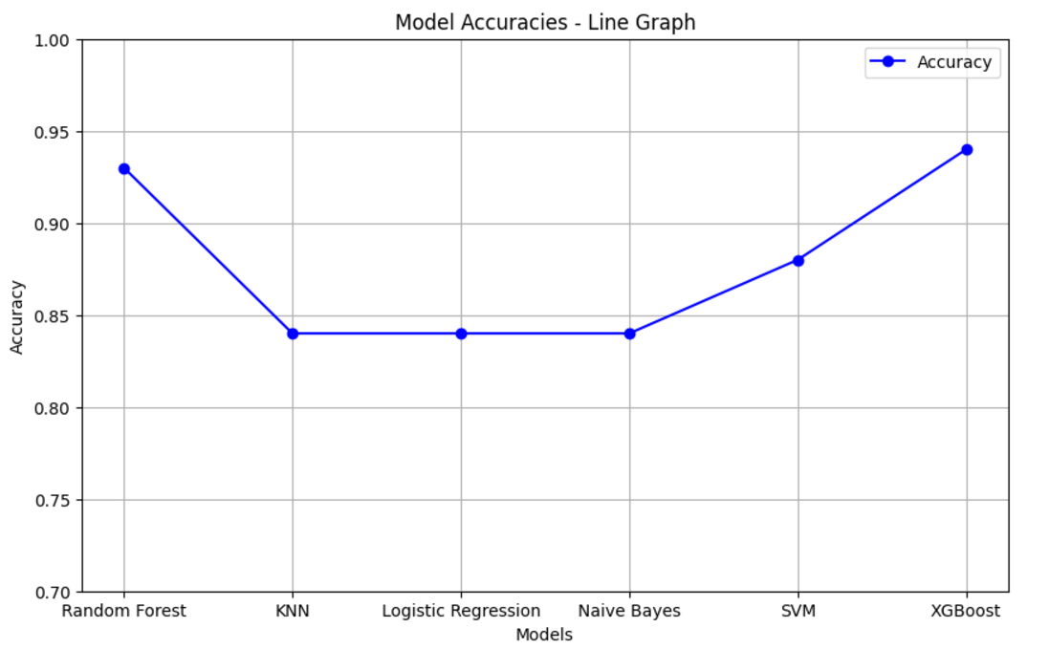
Heart Disease

Slide 19
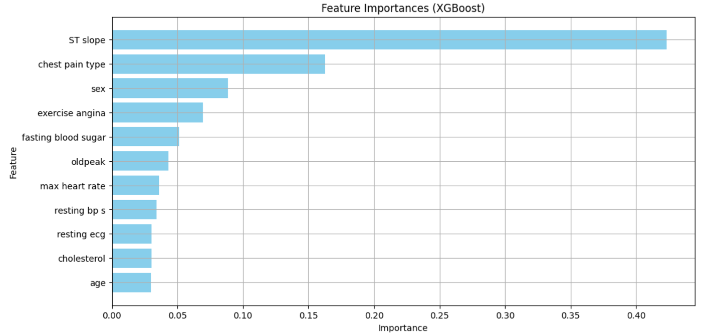
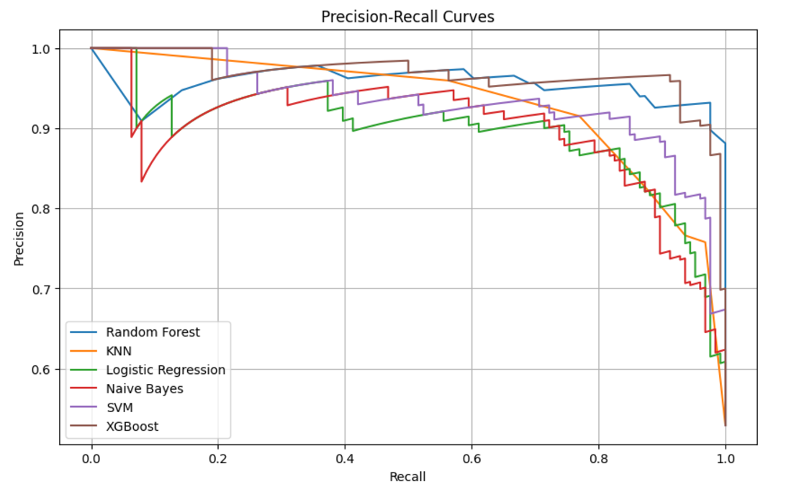

Slide 20
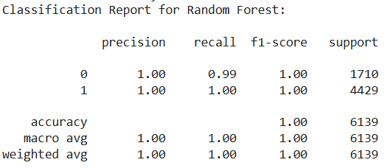
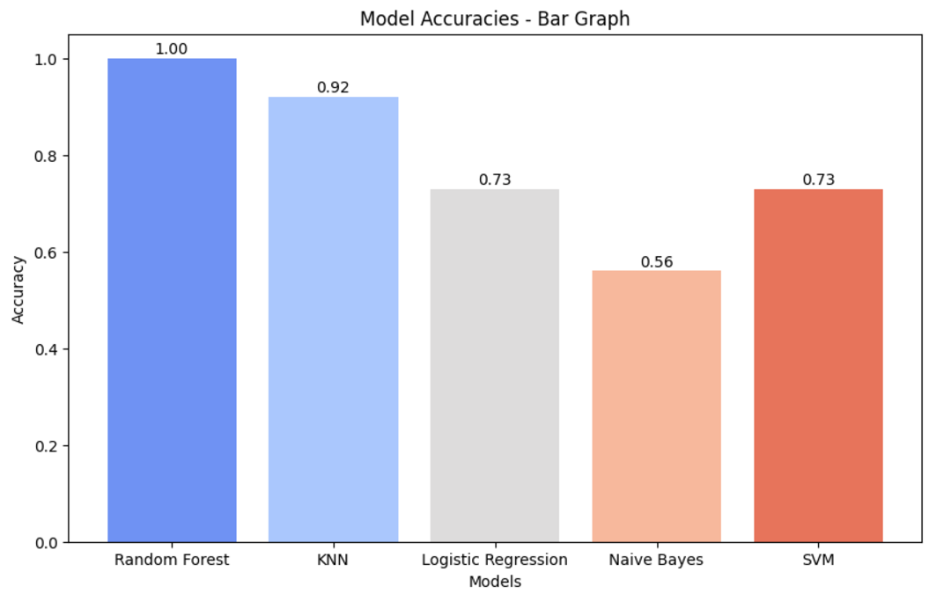
Liver Disease

Slide 21
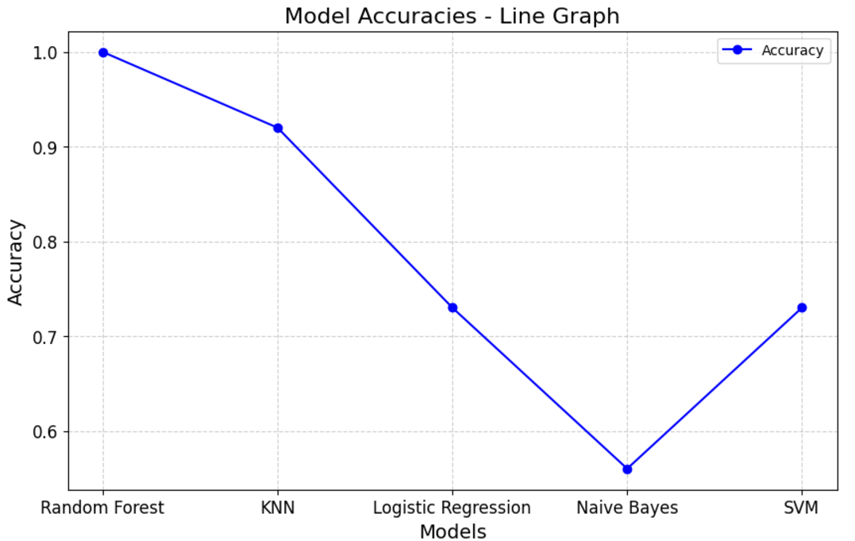
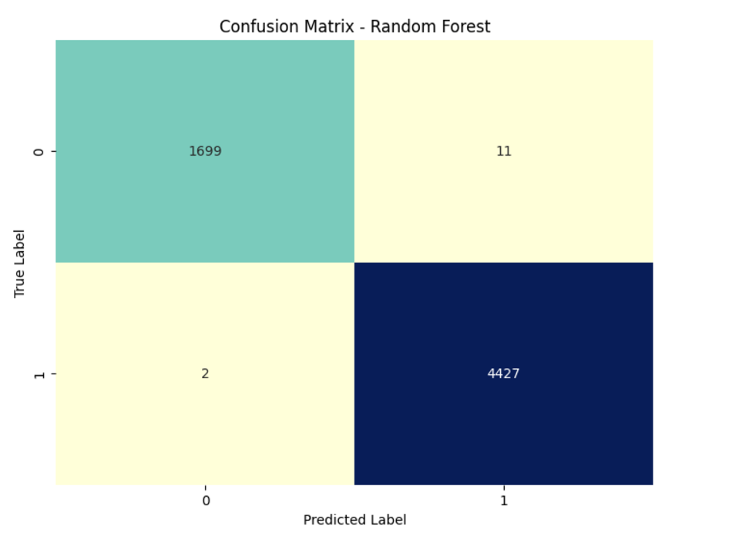

Slide 22
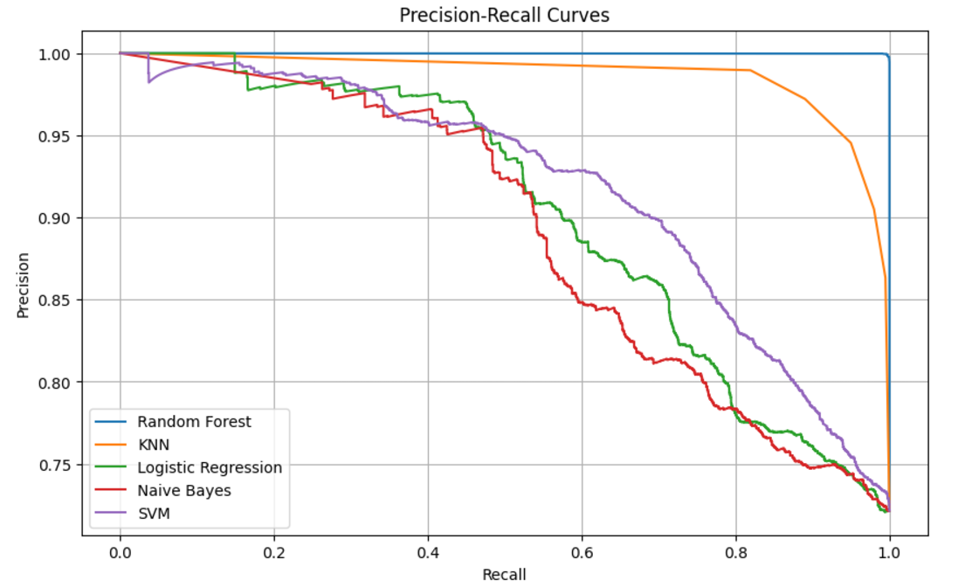
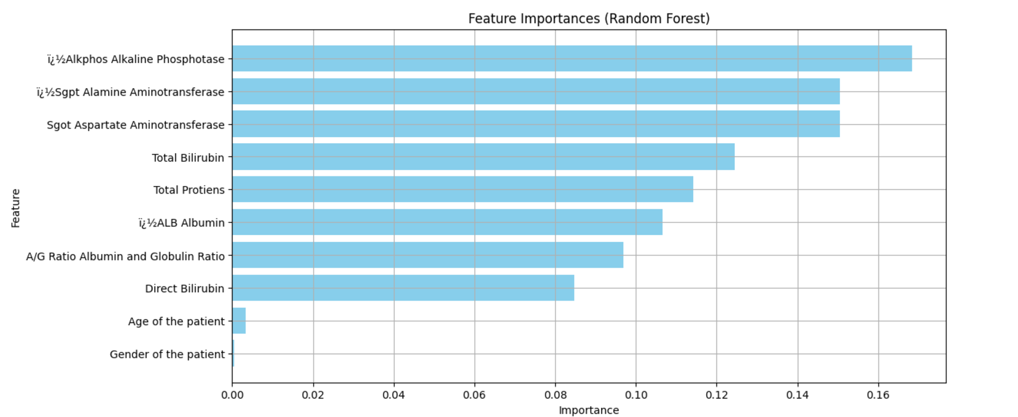

Slide 23
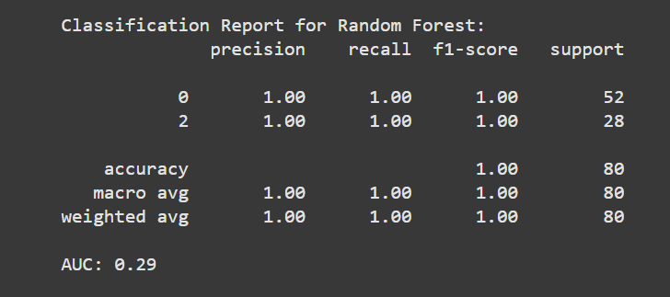
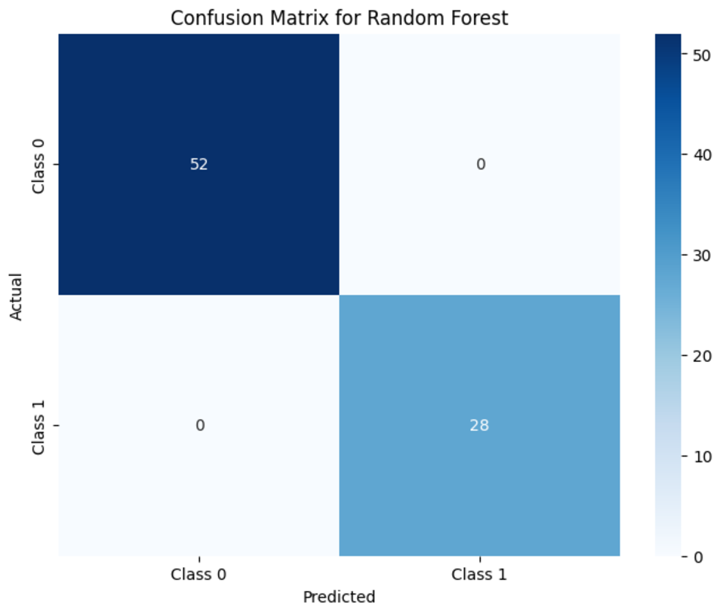
Chronic Kidney Disease

Slide 24
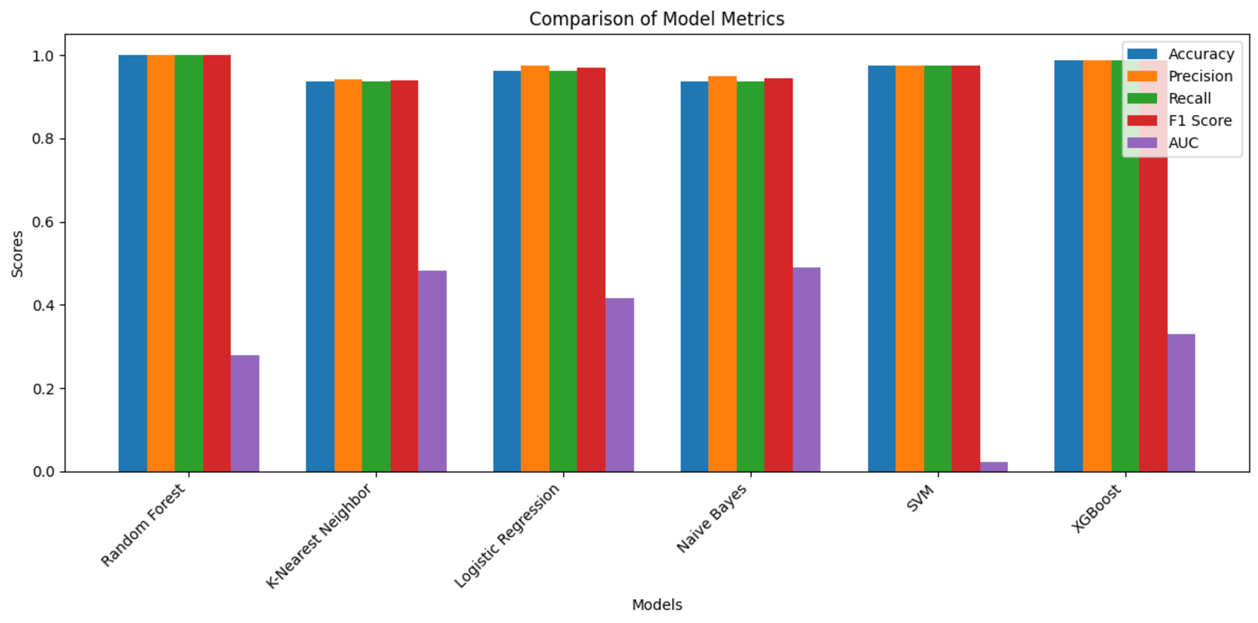

Slide 25
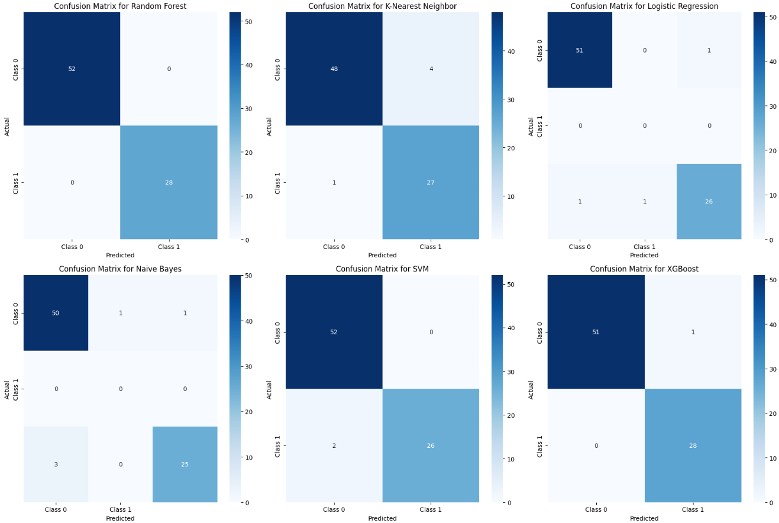

Slide 26
Conclusion and future work
In conclusion, the proposed web-based application for multiple disease prediction aims to offer a convenient and user-friendly platform where users can predict multiple diseases in one place. By integrating various machine learning models and developing a seamless web interface, the system will provide comprehensive health insights in a single, accessible platform.
This project brings innovation by focusing on multi-disease prediction within one application, which sets it apart from existing solutions that typically handle only individual diseases. With a solid foundation in both software and hardware, the platform is designed to improve accessibility and efficiency, contributing to enhanced health management for users.
Potential for Future Enhancements: As the application evolves, additional features such as personalized health recommendations, preventive care suggestions, and integration with electronic health records (EHR) could be incorporated to make the platform more comprehensive and impactful.

Slide 27
Reference
It should be IEEE format like,
Author name(s), “Title of the paper”, Journal name, Vol no, Issue No, Page No, Year of publication, DOI NO, ISBN / ISSN No, Impact factor/ SNIP, etc.
No URL links

Slide 28
Contribution of all the members
Mention all the members with contribution
S.No | Roll No | Name | contribution
1 | 23BAI10105 | Mehul Kumar Patel
2 | 23BAI10291 | Mayank Rathore
3 | 23BAI10006 | Ayush Yadav
4 | 23BAI10038 | Muskan Kumari
5 | 23BAI10066 | Archita Bajpai

